Slide 1
Cài thư viện tensorflow trên win 10

Slide 2
Cài tensorflow trên GPU
CUDA
CuDNN
Thêm các cài đặt cần thiết
Microsoft C++ Redistributable for Visual Studio 2015, 2017 and 2019
cudart64_101.dll
Cài Python và VSCODE

Slide 3
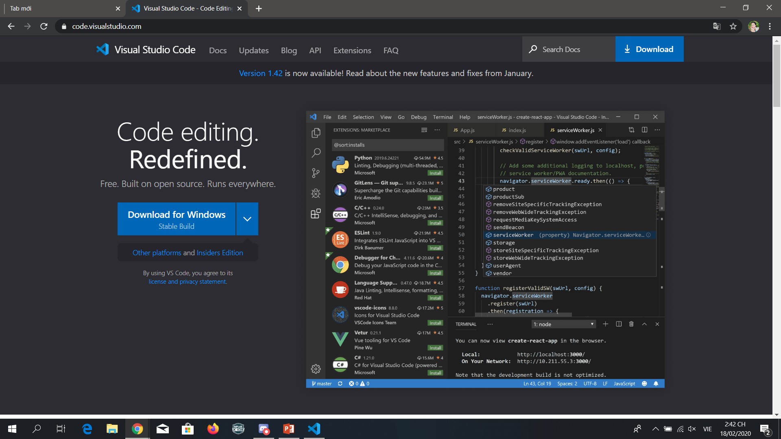
https://code.visualstudio.com/

Slide 4
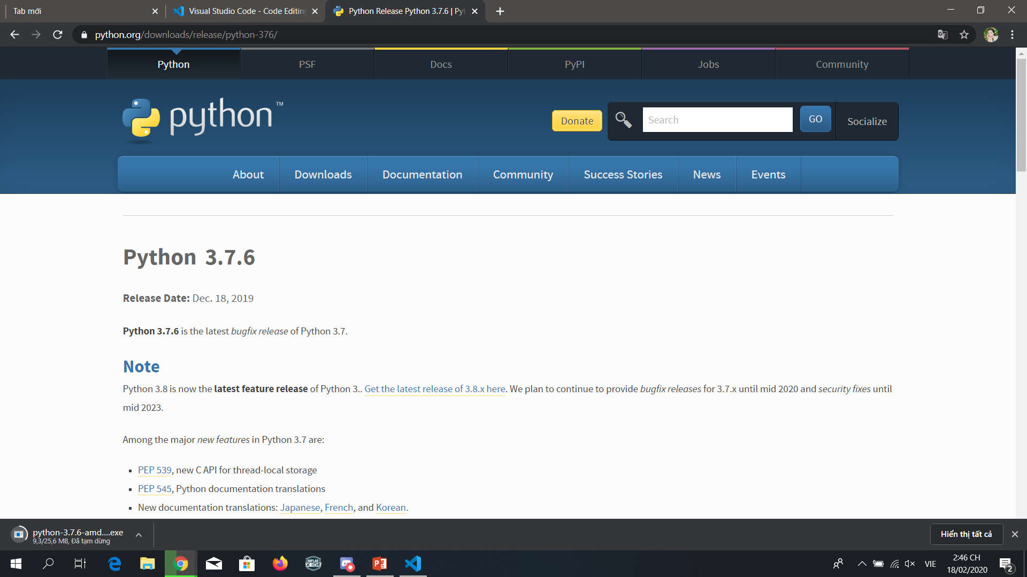
https://www.python.org/downloads/release/python-376/ Windows x86-64 executable installer

Slide 5
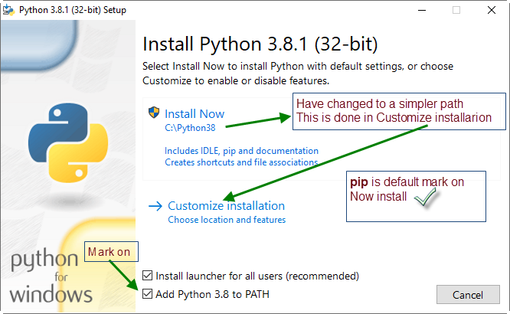
3.7.6

Slide 6
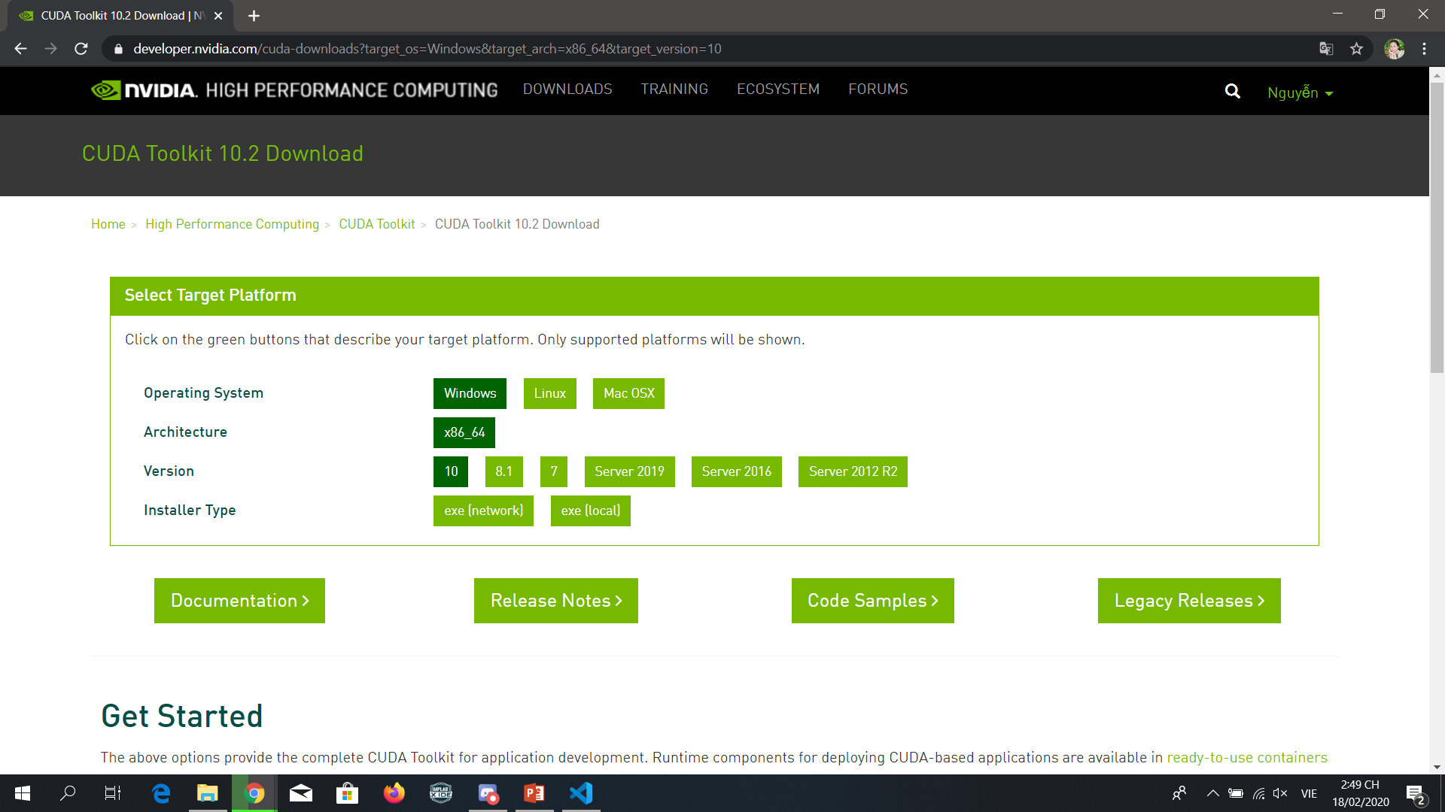
https://developer.nvidia.com/cuda-downloads

Slide 7
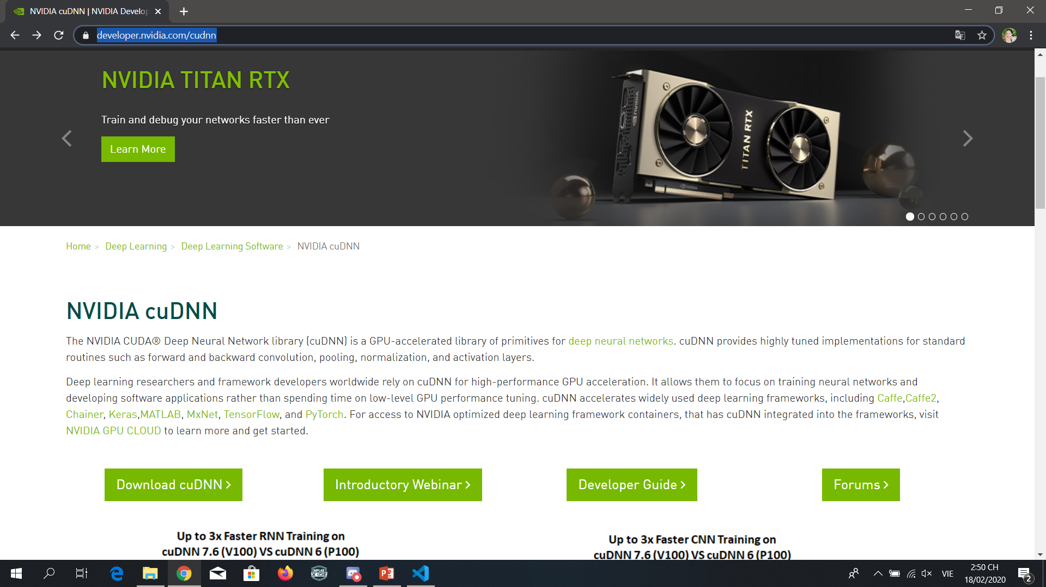
https://developer.nvidia.com/rdp/cudnn-download

Slide 8
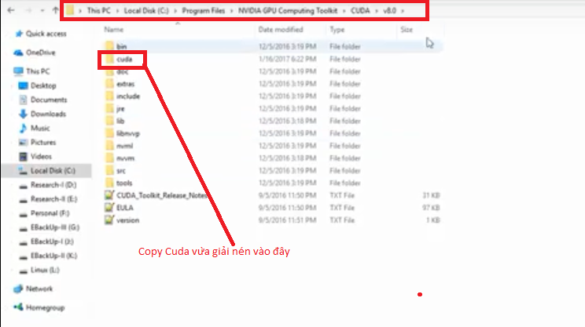
1 - Giải nén file zip cuDNN được file có tên “cuda”. 2 - Copy file “cuda” vào C:/Program files/NVDIA GPU Computing Tookit/CUDA/v10.2

Slide 9

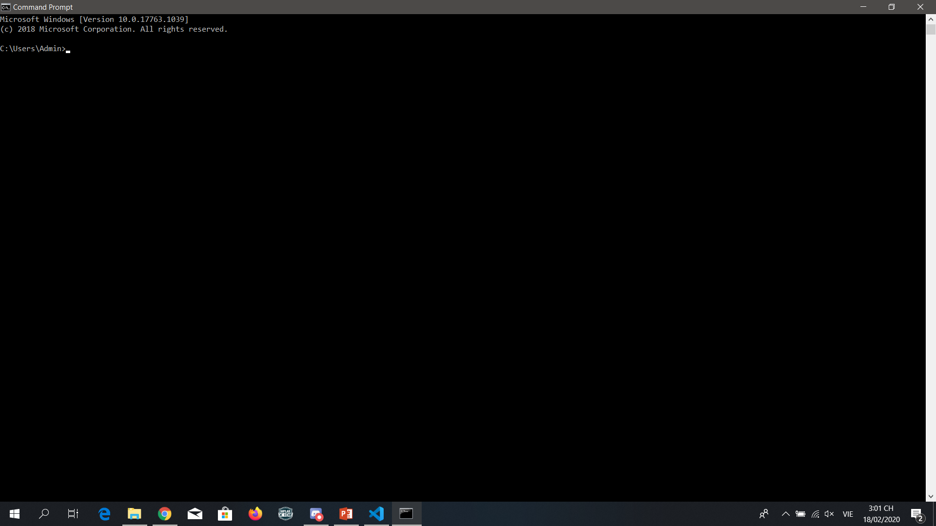
python -m pip install –upgrade pip pip install tensorflow pip install keras ....

Slide 10
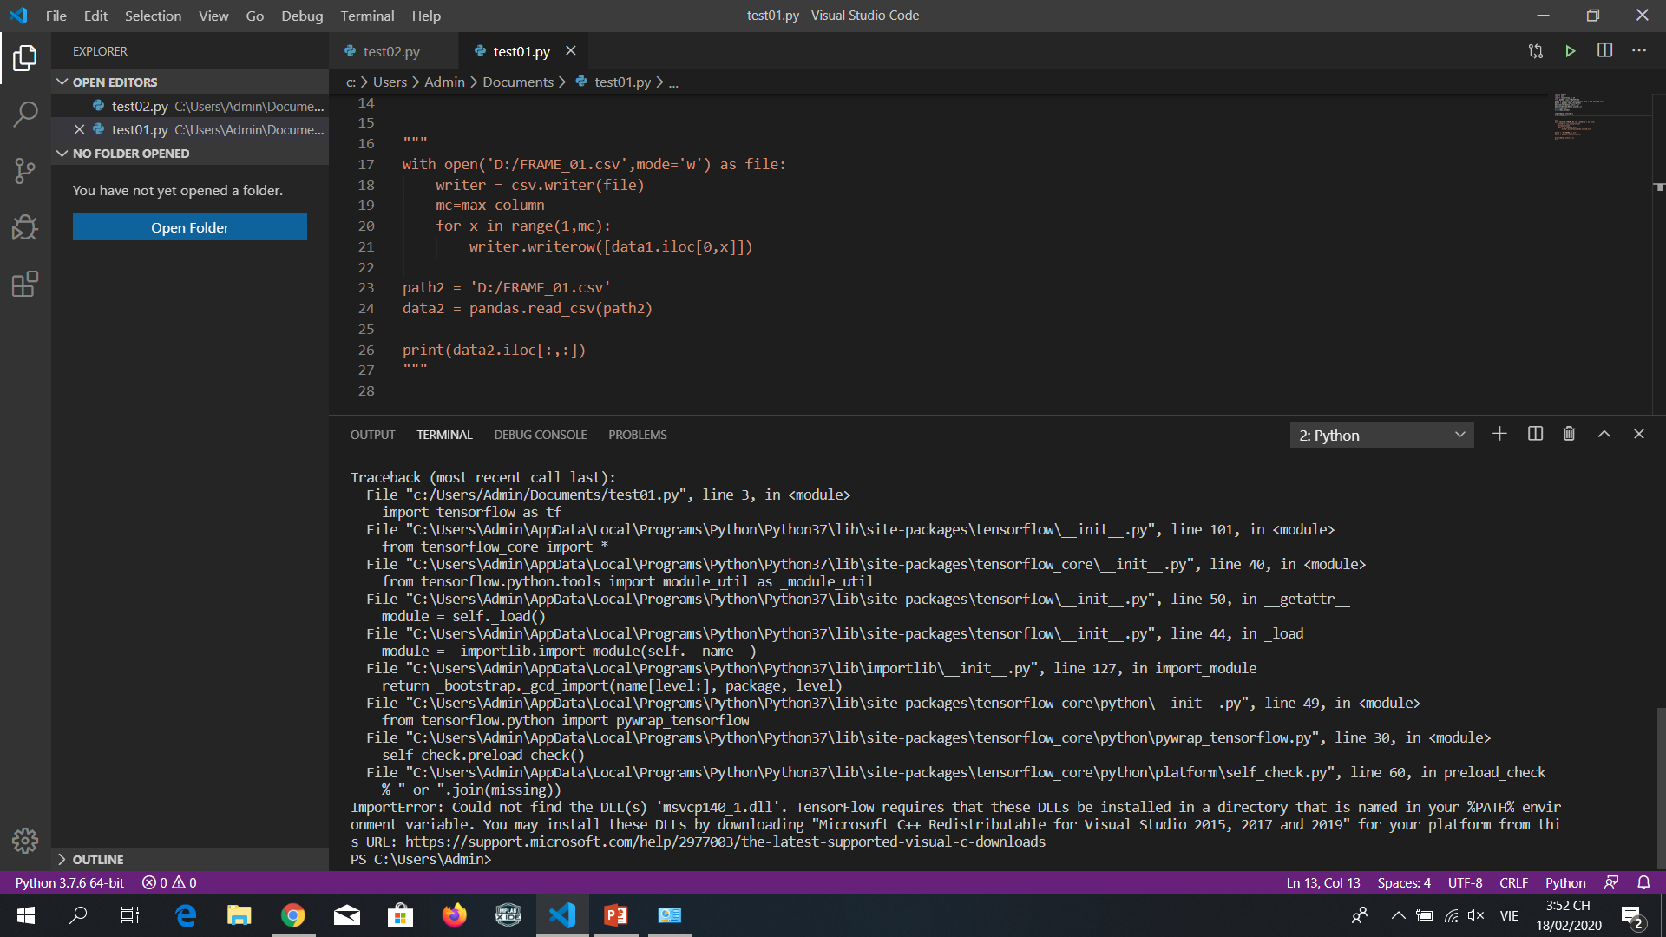
You may install these DLLs by downloading "Microsoft C++ Redistributable for Visual Studio 2015, 2017 and 2019"

Slide 11
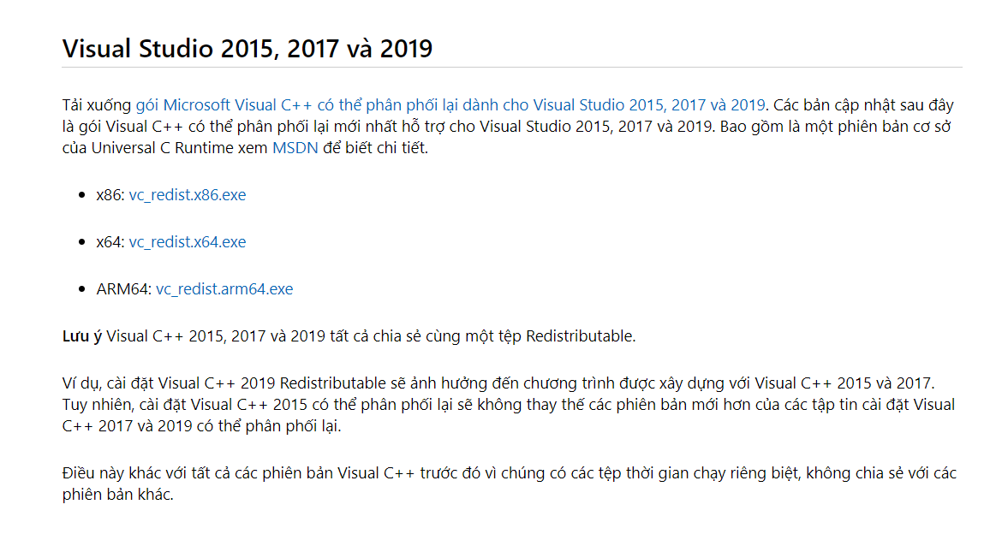
https://support.microsoft.com/vi-vn/help/2977003/the-latest-supported-visual-c-downloads
Cần cài cả 3 phiên bản

Slide 12
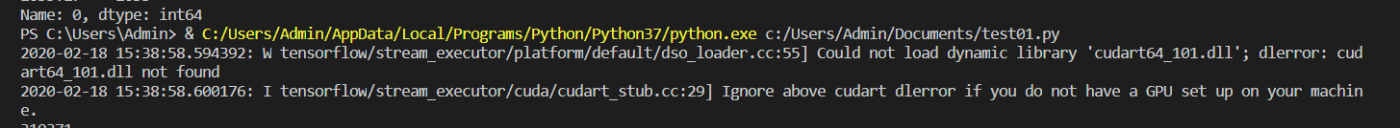
W tensorflow/stream_executor/platform/default/dso_loader.cc:55] Could not load dynamic library 'cudart64_101.dll'; dlerror: cudart64_101.dll not found
‣ https://www.dll-files.com/cudart64_101.dll.html C:\Program Files\NVIDIA GPU Computing Toolkit\CUDA\v10.2\bin chuyển file cudart64_101.dll vào thư mục trên

Slide 13

I tensorflow/stream_executor/platform/default/dso_loader.cc:44] Successfully opened dynamic library cudart64_101.dll

